Slide 2
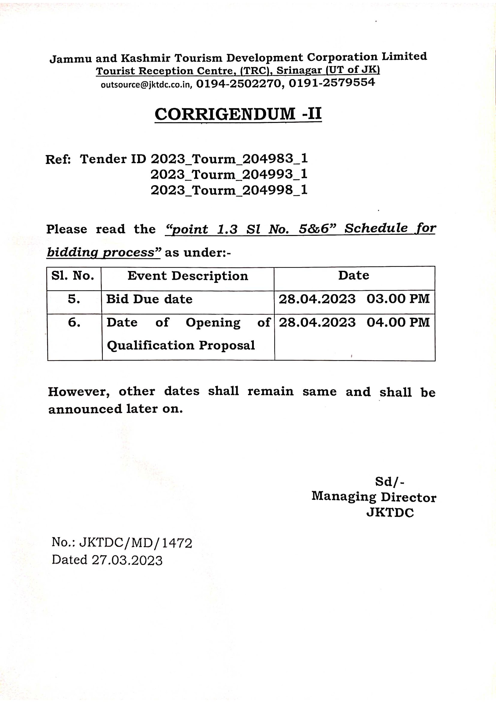

Slide 3
The last date of receipt of queries
is
17th of March, 2023 (Friday)
upto 4.00 PM
The queries will be accepted only on e - mail id
outsource@jktdc.co.in
by:
JKTDC

Slide 4
JAMMU & KASHMIR TOURISM DEVELOPMENT CORPORATION (JKTDC)
GOVERNMENT OF JAMMU & KASHMIR UNDERTAKING
JKTDC (“The Authority”) intends for Development (Design, Refurbishment, Upgradation), Operation & Maintenance of Select Tourism Assets owned by the Authority through Public Private Partnership in the following three bundles. (Each bundle is separate project)
Bundles | Assets / Locations | Est. Project cost
Bundle I (Concession format) | Pahalgam club & convention center and Pahalgam Hutments & Hotel Alpine | INR 108.44 crores
Bundle II (Concession format) | (i) Tourism facilities at Sanasar Lake (ii) Tourist Bungalow Kud and (iii) Hotel Maple Kud | INR 48.89 crores
Bundle III (License format – each location is separate project) | (i) Ramban Cafeteria, (ii) Tourist Bungalow Ramban, (iii) Tourist Bungalow Seri-Ramban, (iv) Tourist Bungalow Banihal, (v) Hotel Maple Banihal and (vi) Cafeteria Qazigund | INR 6.86 crores
INTERNATIONAL COMPETITIVE BIDDING
Request for Proposals are invited from reputed National or International entities, joint ventures for undertaking Development, Operation & Maintenance of select tourism assets (bundle-wise). Concession period for Bundle – I & II is 30 years and License period of 15 years for Bundle –III.
For Bundle I & II, the Authority has adopted an online single-stage two parts e-forward auction process accessible at https://www.jktenders.gov.in for Bidder selection for award.
For bundle III, the Authority has adopted an online single-stage two parts bidding process.
Bid documents can be downloaded from www.jktenders.gov.in. Bidder shall make respective payments (INR 1 Lakhs for Bundle I, INR 50,000 for Bundle II and INR 10,000 for bundle III) towards bid processing fee as stipulated in the RFP document.
Important dates
Invitation of RFP | 13.02.2023
Last date for receiving queries | 27.02.2023
Pre-Bid Conference | 28.02.2023
Bid Due Date | 31.03.2023
Interested Bidders may reach the office for any additional clarification in person:
The Managing Director, JKTDC,
Srinagar- Kashmir ,Tourist Réception Centre, Raj Bagh, Srinagar, Jammu and Kashmir
Tel: 0194 - 2502274

